Slide 1
IX TAYSAD AFTERMARKET CONFERENCE Istanbul, 25.May 2018
AFTERMARKET OVERVIEW
EUROPE G5 / TURKEY / RUSSIA / AFRICA
Zoran Nikolic, Managing Director

Slide 2
About wolk after sales experts
Zagreb
Sofia
Brussels
Stuttgart
Rome
London
Amsterdam
Zurich
Stockholm
Bucharest
Istanbul
Berlin
Management consultancy specialized in the automotive aftermarket in Europe
Established 1994
Based in Germany
International alliance of 10 after sales consulting companies
Milan
Frankfurt
Hamburg
Lisboa
Casablanca
Budapest
Berlin
Moscow
Barcelona
Belgrade
Prague
Madrid
Vienna
Toglliatti
Zurich
Warsaw
Munich
Riga
Kyiv
Paris

Slide 3
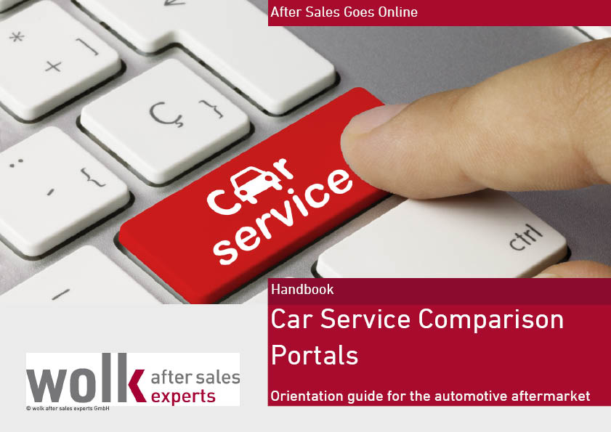
Aftermarket sales and marketing services
Aftermarket Studies / Databases
Aftermarket Wall Charts
Tailored market research
Marketing / Sales Concepts
Aftermarket Strategies
Workshops
Performance improvement
Training / coaching
Active sales team

Slide 4
Agenda
1
What influences the Aftermarket today?
2
Aftermarket Facts & Figures
Europe G5
Turkey
Russia
Africa
4
Conclusions & Outlook

Slide 5
Aftermarket structure in Europe

Slide 6
GenEral Influence FactOrs
Society
Urbanisation
Shareconomy
Environmental awareness
Fast pace
Pluralization/complexity
Technologies
Digital transformation / IOT
Alternative powertrain
Connected car
Assistance systems
3D Print
artificial intelligence AI
Market players
New players - Intermediates
Concentration process
Globalization
Legislation
BER
E/B/S Call
CO2

Slide 7
Agenda
1
What influences the Aftermarket today?
2
Aftermarket Facts & Figures
Europe G5
Turkey
Russia
Africa
4
Conclusions & Outlook

Slide 8
Global view on vehicle park – forecast
+39%
Growth velocity:
1,3 cars per second
+23%
+39%
+54%
Evolution vehicles in operation below 7.5 tons. Source: Tec Alliance, wolk after sales experts
Notes:
By 2020, the number of cars is expected to increase to more than 1.3 billion, particularly in the Asian region, the private ownership of vehicles will increase substantially.
By 2025, the world stock of vehicles is expected to increase to more than 1.5 billion.

Slide 9
Nine clusters of the European aftermarket
DE, AT, CH
DK, SE, NO, FI
UK, IE, BE, NL
16,5% of the European car park
4,0% of the European car park
14,3% of the European car park
20,6% of the total aftermarket volume
5,9% of the total aftermarket volume
17,1% of the total aftermarket volume
FR, ES, PT, IT
EE, LV, LT, PL
RO, BG, TR
29,3% of the European car park
7,3% of the European car park
6,0% of the European car park
29,4% of the total aftermarket volume
5,6% of the total aftermarket volume
5,0% of the total aftermarket volume
RU, BY, UA
AL, BA, HR, RS, MK, GR
CZ, HU, SK, SI
16,1% of the European car park
3,1% of the European car park
3,5% of the European car park
11,4% of the total aftermarket volume
2,3% of the total aftermarket volume
2,8% of the total aftermarket volume

Slide 10
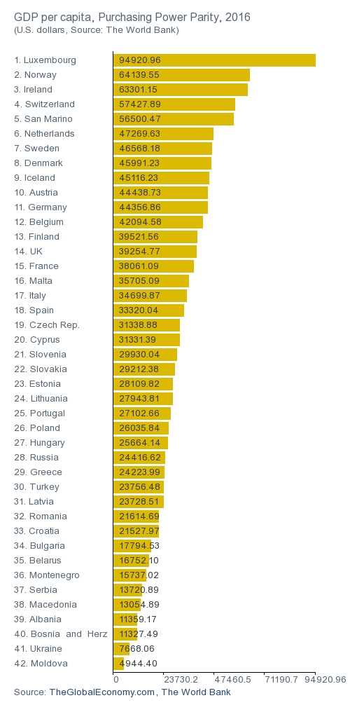
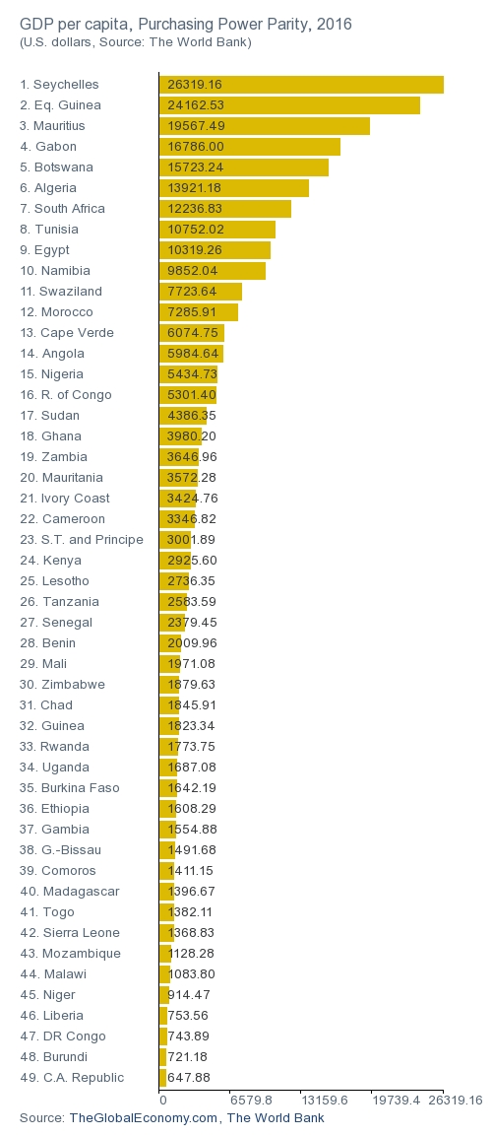
Comparison and ranking Europe vs. Africa
GDP per Capita in US $
Europe
Africa

Slide 11
Key figures Car Aftermarket in Europe G5
TOTAL aftermarket volume⁴ in bn EUR in Europe G5:
Car park: 167,2 m cars¹
73,1 bn. €
Car density: 526 cars per 1.000 inhabitants
Ø age of car park: 9,8 years
Aftermarket volume by 10 product groups in Europe G5:
IAM parts wholesalers: 8.541²
∑=21,6 bn EUR
# workshop outlets³: 214.261
∑=6,5 bn EUR
∑=8,4 bn EUR
437 EUR per car per year
∑=3,3 bn EUR
statistics
∑=10,2 bn EUR
19 IAM workshop outlets per wholesaler
∑=5,8 bn EUR
∑=2,6 bn EUR
∑=2,5 bn EUR
1.034 cars per IAM workshop
∑=10,2 bn EUR
∑=2,0 bn EUR
¹ only passenger cars; ² number of companies; ³ IAM+OES workshops incl. specialists; number of outlets; ⁴ Only material for passenger cars at end consumer prices excl. VAT. 2016 = estimated

Slide 12
Key figures Car Aftermarket in Turkey
TOTAL aftermarket volume⁴ in bn EUR in Turkey:
Car park: 12,0 m cars¹
3,8 bn. €
Car density: 141 cars per 1.000 inhabitants
Ø age of car park: 9,6 years
Aftermarket volume by 10 product groups in Turkey:
IAM parts wholesalers: 4.114²
∑=1,2 bn EUR
# workshop outlets³: 29.863
∑=0,5 bn EUR
∑=0,5 bn EUR
314 EUR per car per year
∑=0,4 bn EUR
statistics
∑=0,4 bn EUR
6 IAM workshop outlets per wholesaler
∑=0,3 bn EUR
∑=0,2 bn EUR
∑=0,1 bn EUR
403 cars per IAM workshop
∑=0,1 bn EUR
∑=0,1 bn EUR
¹ only passenger cars; ² number of companies; ³ IAM+OES workshops incl. specialists; number of outlets; ⁴ Only material for passenger cars at end consumer prices excl. VAT. 2016 = estimated

Slide 13
Key figures Car Aftermarket in Russia
TOTAL aftermarket volume⁴ in bn EUR in Russia:
Car park: 40,9 m cars¹
10,4 bn. €
Car density: 280 cars per 1.000 inhabitants
Ø age of car park: 9,9 years
Aftermarket volume by 10 product groups in Russia:
IAM parts wholesalers: 15.803
∑=6,0 bn EUR
# workshop outlets3: 54.509
∑=0,7 bn EUR
∑=0,6 bn EUR
255 EUR per car per year
∑=0,4 bn EUR
statistics
∑=1,2 bn EUR
3 IAM workshop outlets per wholesaler
∑=0,7 bn EUR
∑=0,2 bn EUR
∑=0,2 bn EUR
806 cars per IAM workshop
∑=0,3 bn EUR
∑=0,1 bn EUR
¹ only passenger cars; ² number of companies; ³ IAM+OES workshops incl. specialists; number of outlets; ⁴ Only material for passenger cars at end consumer prices excl. VAT. 2016 = estimated

Slide 14
Key figures Car Aftermarket in Africa
TOTAL aftermarket volume⁴ in bn EUR in Africa:
Car park: 33,5 m cars¹
8,7 bn. €
Car density: 39 cars per 1.000 inhabitants
Aftermarket volume in Mio. EUR in selected markets in Africa:
Ø age of car park: > 13 years
IAM parts wholesalers: 4.000
# workshop outlets3: 21.800
statistics
257 EUR per car per year
4 IAM workshop outlets per wholesaler
2.134 cars per IAM workshop
¹ only passenger cars; ² number of companies; ³ IAM+OES workshops incl. specialists; number of outlets; ⁴ Only material for passenger cars at end consumer prices excl. VAT. 2016 = estimated

Slide 15
Agenda
1
What influences the Aftermarket today?
2
Aftermarket Facts & Figures
Europe G5
Turkey
Russia
Africa
4
Conclusions & Outlook

Slide 16
Conclusions
Expenditures per car
Turkey
400 €
Developing market
Increasing volumes
Fragmented workshop landscape
Strong local automotive industry
Following the intrernational standards
Bridge function
Market development line
Europe 5
Developed and saturated markets
Strong consolidation process
Digitalization of channels
Strong competition
Technology driven markets
300 €
Russia
200 €
Africa
Developing market
Huge market potential
Decreasing purchasing power
High amount of DIY
Strong online channel
Mostly undeveloped markets
North- and South Africa create more than 60 % of total volume
Currently not existing aftermarket structures and organisation
High amount of older vehicles
100 €
Introduction
Growth
Maturity
Saturation
100
200
300
400
500
Car park density per 1.000 Inhabitants

Slide 17
Mid term Outlook 2025
Europe G5
Turkey
Russia
Africa
Market professionalisation (garages / wholesalers)
Consolidation
Digitization of sales channels
Influence of intermediates
New competition between OES and IAM
Influence factors
Macroeconomic issues
Changing the mobility behaviours
New drive technologies
Predictive maintenance
New Business Models
12.00 h
9.00 h
6.00 h
3.00 h

Slide 18
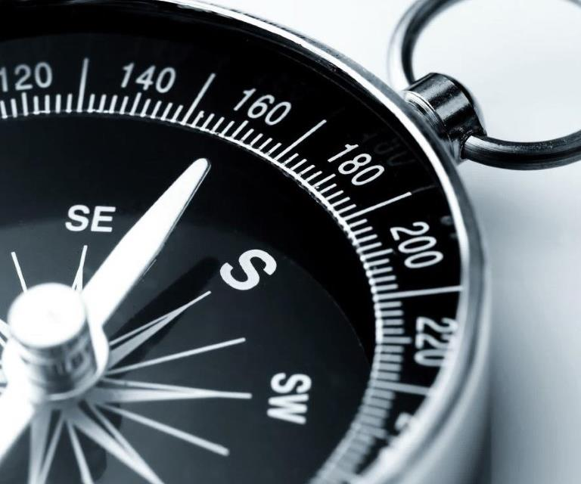
Thank you
Zoran Nikolic
TechnologiePark Friedrich-Ebert-Strasse 75 D 51429 Bergisch Gladbach
Germany
Tel.: +49 (2204) 8425-36 Fax: +49 (2204) 8425-39 zoran.nikolic@wolk-aftersales.de http://www.wolk-aftersales.com

