Slide 1
Outlook
Global Automotive Industry
Jonathon Poskitt, Director, Global Sales Forecasts
TAYSAD Aftermarket Conference
Istanbul, 25 May 2018

Slide 2
LMC Automotive
Industry-leading independent source of market intelligence, analytics and forecasts for nearly 30 years.
Exclusively focused on automotive, LMC offers forecast services covering global sales, production, and powertrains.
Supporting clients with flexible solution and responsive local support. LMC Automotive serves an extensive customer base of OEMs, suppliers, financial firms, logistics providers and government institutions.
With experts located around the world to provide foresight for the road ahead, LMC is the smart choice for automotive intelligence & insight into market dynamics, economic, regulatory & technological change.
Global Presence – Regional Expertise – Local Support
Oxford
Frankfurt
Seoul
Detroit
Tokyo
Shanghai
Bangkok
São Paulo
Sales – Production – Powertrain
Light Vehicles
Medium/Heavy Commercial Vehicles

Slide 3
Outline
Current global automotive environment
Trends and medium-term outlook
Long, long-term transformation

Slide 4
SAAR Development
Global Light Vehicle Selling Rate (mn/yr)

Slide 5
Global Economic Outlook – 2018
Global
US
Brazil
Japan
China
Eurozone
2018
3.1%
2018
2.8%
2018
1.9%
2018
1.4%
2018
6.3%
2018
2.2%
Gaining speed - pushing through 3%
Stronger growth but uncertainty remains
Fragile recovery
Moderating but holding
Managed slowdown
Stable with downside risk
2018 growth driven by US boost and emerging market recovery
All major economies in expansion, though slowdown taking place in many cases

Slide 6
2018 LV sales: 97.5 mn, +2.3% from 2017
Global LV Sales – 2018 Out of the Gate
World
16 17 18F
C&E Europe
North America
Western Europe
China
16 17 18F
16 17 18F
16 17 18F
16 17 18F
Asia Pacific minus China
South America
16 17 18F
16 17 18F
Notes:
This year, sales growth in the very near term (this year) is set to remain pretty solid at 2.3%.
As we’ve just heard in Europe growth is expected to slow this year in West Europe and in the East continue to be supported by a Russian recovery.
I won’t dwell on the other regions because other speakers will provide a little more detail on these, but very simply, North America has matured to a kind of plateau at a high level, the S America recovery continues to post strong growth as is the case in India, although some of this region is tempered by a cooler Japanese market. China, the driver of global growth volume has been suffering from the distorting effect of sales incentives and their removal…
But of course there are risks to this view:
Trade Tensions: Trump threats to impose additional tariffs on imports to the US, including duty on car imports
Decrease world trade which as we’ve highlighted, underpins the recent strong growth
Steel and Aluminium tariffs already introduced but have been significantly watered down
Car duty threat has been somewhat calmed by moves made by the Chinese Authorities: softening stance on JV ownership caps and duty reductions.
But, still, wars of words have escalated in the past
Brexit risks: likelihood of a trade deal has risen with the agreement of a transitional phase
Russian isolation: our pan European forecast is underpinned by the potential of Russia to offset the slow growing mature markets
But Syrian crisis, accusations of cyberwarfare and other diplomatic tensions have seen Russia follow a more isolationist path
Although virtually closed automarket : imports only 10%, exports around 6%, inward investment supports growth
BMW new plant in Kaliningrad (open 2021, breaking earth 2018), MB, Esipovo plant construction started, due to open in end 2019
War could help oil price, though!
Technical market risks: WLTP in Europe
The change of measurement of emissions from NEDC to WLTP could upset the local government tax treatment of cars
UK and Germany seem to modestly unaffected, but lack of clarity in France and Spain with the Netherlands likely to treat this as a tax windfall
Seasonal effects of demand: pre-imposition spike followed by a lull. Could weaken 2019 if taxation is sustained.

Slide 7
Brazil and Russia LV markets finally turning around
Brazil Selling Rate (mn/yr)
Russia Selling Rate (mn/yr)
Will trend continue, and what risks are ahead?
Notes:
Brazil – pace of economic recovery appears to be weakening, but sales very strong in April after weak march – Oct election unpredictable
Russia -

Slide 8
North America Outlook
North America Market Forecast
2018 FY
-3.5%
Millions
0.0%
-0.7%
North America sales slowing after record 2016 result
Expected to remain strong by historical standards

Slide 9
Europe Outlook
2018 Outlook
European Market Forecast
France: +80k
21.9
22.3
19.8
20.6
21.3
Germany: +70k
Italy: +80k
Spain: +110k
Millions
UK: -130k
Russia: +210k
Turkey: 0k
Growth momentum continues in Europe, though UK acts as a drag
Limited growth in France and Germany beyond 2018

Slide 10
China Outlook
Global LV Sales – 2018 Out of the Gate
Stimulus package + payback
Growth + mini-stimulus, restrict
car purchasing.
Tax cut in late 2015 and 2016
Reduced
tax cut,
payback
Return to growth,
but ongoing policy risk

Slide 11
Global Sales: Near-term
China still dominates growth as mature markets fade
Global Sales (mn)
Short-term outlook remains positive
2018 slow: China ‘hangover’ and fading US/UK market
2019 pick-up: China pace returns
Risks: Trade Tensions, Brexit, Russian isolation, Iran sanctions
Notes:
Nudging out a little bit further, our base case forecast shows that China and the emerging markets still dominates but the mature markets retreat.
But I think what this highlights here, are the impacts of growing risks to the forecast in a (perhaps using an overused word) in a dynamic world.
Until two week ago, I would have just mentioned the growing Brexit risk or China/US trade concerns. But only a few days ago we are now facing significant risks in the Iranian marketplace: Given OE’s downgrade of the Iranian economy, the contribution to growth over this period has been cut by about half a million units.
Iran’s automotive supply-side impact…
Russia’s isolation?
But as I alluded to it a moment ago it is trade which is developing as a key risk theme
So compared to this time last year, the news doesn’t seem to be very good…
So where does this leave Europe:
And it’s very complex…
Sales Growth in 2019 quickens slightly to 3% as China’s incentive payback period subsides.
But rates of growth are a little muted because of the maturing pace of EM market recoveries (Brazil/Russia) and the flatlining in US/Europe/Japan
US/Japan and UK contract.
Indian pace provides support.
Brazil overtakes France in 2020
India Overtakes Germany in 2018

Slide 12
Global Sales: Longer term
Globalization Presses on!
Subtle movement as mature markets continue to lose ground to emerging
97.5 Million
2.3% CAGR
114.1 Million

Slide 13
Global Production
Millions
Healthy
Rest of World
Asia-Pacific
Stable
Asia CAGR 3% - Outpaces slightly – Sourcing decision balance shifts to China
Europe CAGR 2% - EE and CE drive growth; WE flat
NA CAGR 1% - Growth restarts post 2020 with investment
SA CAGR 4% - Region in recovery mode though risk remains
MEA CAGR 6% - Growth to fill capacity but sanctions?
Risk
2017
2021
2025

Slide 14
Technology R&D and SUV importance is creating pressure to reduce activity in ‘traditional’ areas
Global LV Sales – 2018 Out of the Gate
Number of SUVs in production in North America and Europe grows
Number of conventional bodystyle models falls
In 2017, 32% of LVs were SUVs, with this set to grow to over 36% by 2020
Conventionals still retain largest market share
SUV
2015
2020
2025
MAV, sedan,
hatch, wagon, sporty

Slide 15
Global Light Vehicle Fleet
Global LV Parc (bn)
The combination of Autonomous Vehicles and Shared Mobility likely to disrupt ownership model, though not for some time
Sales nearing 100 mn units/year. Scrappage will continue to rise (from circa 50 mn/year to 60 mn/year); further parc growth inevitable
Mature market fleet growth to slow while emerging markets see rapid fleet increases.
Positive momentum for Aftermarket industry

Slide 16
Global Truck Production (GVW>6t)
Global Production, by Region (mn)
The global truck market (GVW>6t) posted a new record in 2017, with sales rising to 3.0 mn units (+21%)
China drove sales and production higher, though some moderation this year

Slide 17
Outline
Current global automotive environment
Trends and medium-term outlook
Long, long-term transformation

Slide 18
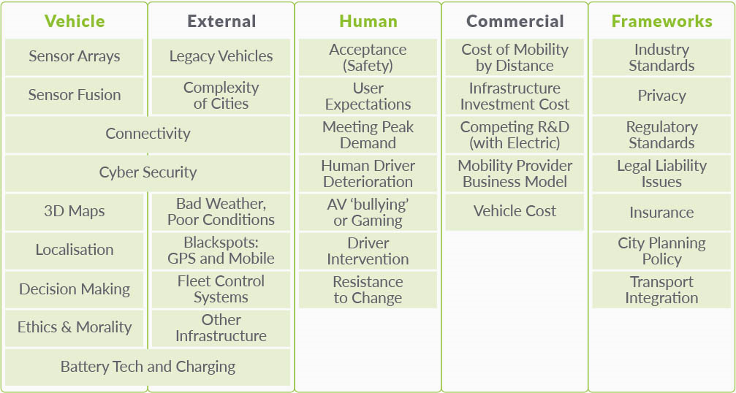
Many things to be solved before shared AVs can work
Global LV Sales – 2018 Out of the Gate

Slide 19
Summary AV forecasts

Slide 20
Summary
Global economy solid in near-term, with growth forecast across major economies
Auto industry well placed for another strong year globally though risks remains, including: economic, political, industry-specific
SUVs will continue to outpace industry and all other segments
Parc continues to grow and disruption from Autonomous Vehicles still some time away

Slide 21
forecasting@lmc-auto.com
lmc-auto.com

