Slide 1
MANN+HUMMEL Importance of Innovative Approaches in Independent Aftermarket for Sales and Trade Marketing
Onur Özyapıcı – Sales Director
Istanbul
26th May 2017

Slide 2
Table of content
1
The MANN+HUMMEL Group at a glance
2
Current trends affecting the independent aftermarket business
3
Innovative approaches in sales and trade marketing strategies
4
A good practice : Innovative cabin filter

Slide 3
The MANN+HUMMEL Group
1

Slide 4
The MANN+HUMMEL Group
At a glance
50
Founded in
1941
Employees
Top patent applicants
in Germany
20,000
Our vision : ‘Leadership in Filtration’.
Filtration separates the useful from the harmful – something we are commited to working on every day. (Alfred Weber, CEO)
Sales in billion €
4
70 locations
3,000 patents and applications
24
filters per second
Notes:
As a global player, 20,000 employees work for us at more than 70 locations on five continents.
Each second, 24 MANN+HUMMEL filters are produced, shipped, sold and installed worldwide.
We regularly count among the top patent applicants in Germany.
We hold more than 3,000 patent applications, patents and utility models.
We understand the requirements and demands of customer and markets throughout the world.
Today, we make about 4 billion euros in sales revenue

Slide 5
Current trends affecting the independent aftermarket business
2
from commercial perspective

Slide 6
Trends Affecting Independent Aftermarket
Main hot topics
Value Chain | Product | Logistics | Technology
Blurred borders between OES and IAM | Spare parts become a commodity | Customer expect tailor-made solutions | Car repair will become more complex (software vs. mechanical parts) needs investment into workshop infrastructure
Rising importance of E-Commerce | Increased product segmentation (good/better/best) | Suppliers and distributors are heavily investing in infrastructure | E-call, connected car, service data
Increased transparency for workshops and car owners | Multi-brand sales | Parts availability is a major business enabler | Multi-channel communication (E-Mail, Skype, Social-Media, VOIP, etc.)
Margin pressure esp. on 2nd trade level and industry | Know-How will become more important than the part itself | Increase of drop-off locations | Digitalisation of processes
Vertical integration of market players | Population becames more health conscious | Increased technical complexity of cars leads to higher # of SKU‘s to fulfill market rqmnts | Electric car and respective infrastructure/business models

Slide 7
Innovative approaches in sales and trade marketing strategies
3

Slide 8
Innovative approaches in sales and trade marketing strategies
Innovation in Solutions x Service x Supply
Competence and experience of a leading OE manufacturer
Technical solutions which meet customer requirements
Innovative products with an excellent value proposition
Dedicated sales team
Product trainings and technical support
Marketing and sales promotion support
Professional supply chain management
Fast, accurate and efficient logistics operations
Excellent reliability – excellent delivery performance

Slide 9
Innovative approaches in sales and trade marketing strategies
To ensure a profitable IAM business, in spite of the increasing competitive pressure,
it is important to:
Generate sales volume growth by
Competitive offer – brand positioning with reasonable pricing strategy
Complete product range
Multi branding in both premium and economy segments
Fulfil customer expectation
Implementation off new products in a short time frame
Listening to voice of customer
Outstanding logistic and delivery performance
Strong marketing support

Slide 10
A Good Practice : Innovative Cabin Filter (Frecious Plus)
4
International
patent
pending
New cabin filter for increased protection against allergens, bacteria and mould

Slide 11
FreciousPlus – Status quo
Why do we need FreciousPlus cabin air filters?
Increasing share of people suffering from allergies (ca. 20 – 25 % of population in Europe)
Pollen (86 % of allergists) and mould (14 % of allergists)
Air coming through ventilation can be up to 5 times more polluted than ambient air on the street
Population becomes more health conscious
Many suffer from heavy
allergies
*American Academy of Allergy Asthma and Immunology (AAAAI); annual growth: 2-6%

Slide 12
FreciousPlus – Target group
Who needs the FreciousPlus cabin air filter?
Allergists
Asthmatics
Families
Health conscious people
Frequent drivers
Drivers of mid-class and upper mid-class vehicles, Vans and family SUVs

Slide 13
FreciousPlus – The solution
Launch of New Innovative Product
Available
for almost every second car
model in the
EU market!

Slide 14
FreciousPlus – The solution
With FreciousPlus your health has priority!
Traps almost 100 % of allergens through natural polyphenol
Reduces the growth of moulds and bacteria by more than 98%
Blocks particulate matter almost completely (PM2.5)
Premium activated carbon offers higher capacity for harmful gases
Anti-allerg test (allergen residual %) ELISA method (high allergic pollen)
No. of living bacteria after 28 days in lab
Filtration of allergens and other pollutants %
Filtration von Allergenen und anderen Schadstoffen %
Prevent
bacterial growth
International
patent
pending
Time (hours)
Frecious Plus Gewöhnlicher Filter
FreciousPlus
Ordinary filter
FreciousPlus
Ordinary filter

Slide 15
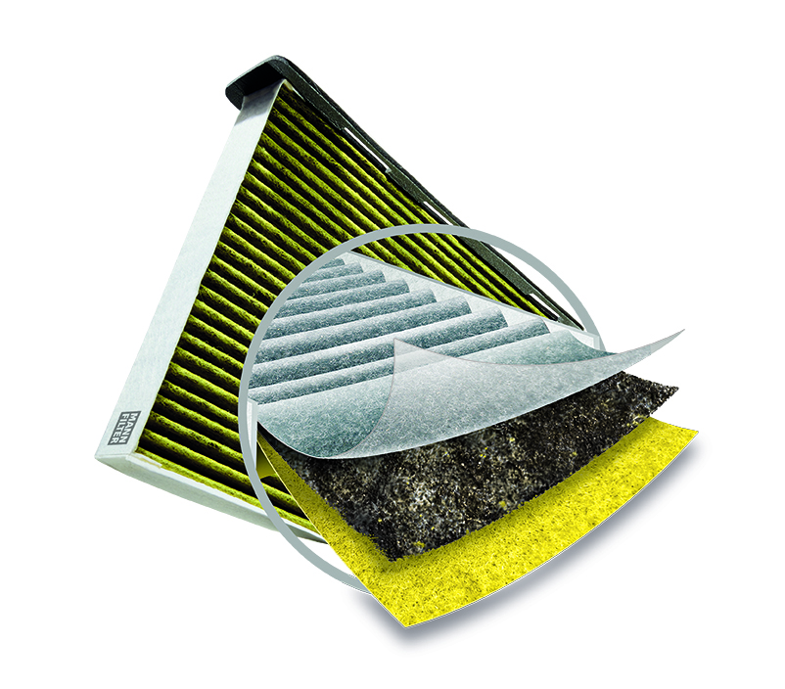
FreciousPlus – The design
Three filtration layers technology
1
Particle filter layer
High efficiency filter medium removes pollen, diesel soot and particulate matter virtually completely
Premium activated carbon layer
Eliminates unpleasant odours and harmful gases, including ozone, sulphur dioxide and nitrogen oxides
Biofunctional layer
Biofunctional coating with natural polyphenol traps allergens. Additional antimicrobial coating blocks nutrition of bacteria and fungi and blocks their growth
2
3
New!

Slide 16
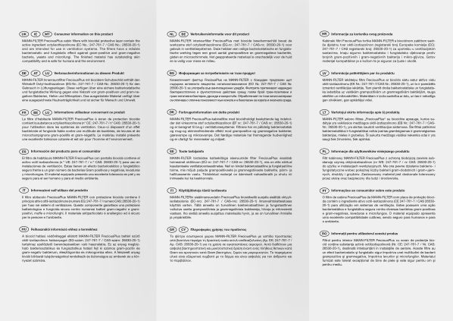
FreciousPlus – The new look
New packaging
New premium packaging
Appealing to end customers through emotional design and product description
5 languages EN, GER, FR, ES, RU
Indication leaflet (24 languages incl. RU + TR)
Installation instruction (updated)

Slide 17
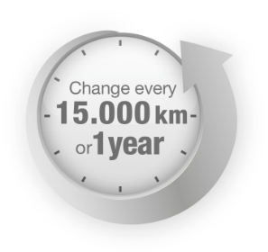
FreciousPlus – Additional benefits
Many advantages – for everybody!
Three filtration layers for best filtration performance
Innovative premium product (international patent pending)
Product of the year 2016 in France „Produit de l’année“*
Air conditioning servicing with benefits
Safety and comfort in the car
Possibility to point on importance of the regular change of cabin air filters
in car driver communication Comprehensive sales support for garages and wholesalers
Logo „Produit de l’année (product of the year) »
* Online study an among more than 10,000 representative consumers in France conducted by market research institute Nielsen

Slide 18
Thank you…
Onur Özyapıcı, Sales Director

