Slide 1

AFTER-SALES STRATEGY & EXPECTATIONS
26 MAY 2017

Slide 2
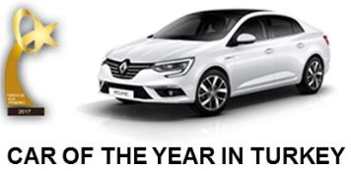
CONTENTS
01 RENAULT AS BUSINESS OVERVIEW
02 EURASIA REGION
03 NEW AS PURCHASING ORGANISATION
04 OUR EXPECTATIONS
05 QUESTIONS / ANSWERS

Slide 3
01
RENAULT AS BUSINESS OVERVIEW

Slide 4
2016 PARTS & ACCESSORIES TURN OVER BY REGION/SEGMENT
REGION
SEGMENT
ASIA PACIFIC
MAINTENANCE MECANICAL/WEAR & TEAR/ TYRES
AMERICAS
EURASIA
AMI
EUROPE
BODY/PAINT
STILL HIGH DEPENDANCE ON EUROPE

Slide 5

AS BUSINESS WORLDWIDE / INTERNATIONAL & EUROPE

Slide 6
WHERE IS OUR PLAYGROUND?
CAR PARK IS MAINLY INCREASING OUTSIDE EUROPE
OVERALL MODEL MIX DETERIORATION

Slide 7
NEW BUSINESS APPROACH WITH KEY BREAKTHROUGHS
1. Increase our market share in the overall After-sales Market
Topics | Before 2016 | 2017 – 2020 vision
Benchmark | OEM Benchmark | IAM player
Organization | Silo Organization | USFT organization / BU structure
Management Tools | TO/UIO K /1000 | TO/UIO Market Share
Logistics | "Cost center" | Business development support
Purchasing | Only cost saving | Business growth contributor

Slide 8
NEW BUSINESS APPROACH WITH BREAKTHROUGHS
2. Increase our customer retention
Topics | Before 2016 | 2017 – 2020 vision
Connectivity / Services | No AS offer | AS connectivity offers targeting all Renault / Dacia car park
IS/IT | Old tools with "low reactivity" | New Tools development (Phenix, ADT3, Alias)
Alliance | Limited synergies | Common organization with clear roadmap and target
2nd line (Motrio) | Limited range w/o growth | Region base plan with realistic multi-brand approach
Organization | Roles and resp. were not clear | More power to regions and business oriented / clear roles & responsibilities

Slide 9
02
EURASIA REGION

Slide 10
5 REGIONS, CORE OF OPERATIONS
Key Dates
  2006: the growth in the automotive sector was shifting from Europe to emerging markets
    5 RMC creation: system of management for worldwide activities based on a number of geographical regions
      to be as closely tuned as possible to the needs of its customers
      to run economical activities as near as possible to its operations
  2011: The Group has been taking things even further, making regions even more central to industry competition
  2014: Asia-Pacific, Americas, Eurasia, Europe, Africa-Middle East-India
Mission: reinforce international Group’s development
  To ensure the means to increase efficiency & impact in all markets and to best seek growth where it is most easily found
  To maximize the profitability of each region and conquering new markets

Slide 11
5 REGIONS, CORE OF OPERATIONS
  More autonomy & decision-making power
  CORPORATE FUNCTIONS
    define strategy
    develop standards
    set targets
    provide regions the support
    they need
  REGIONS
    Implement the strategy in their countries with the network and the customer
    STRENGHT: expertise in the field to take operational initiative & send back information to the central offices on the specific needs of their markets

Slide 12
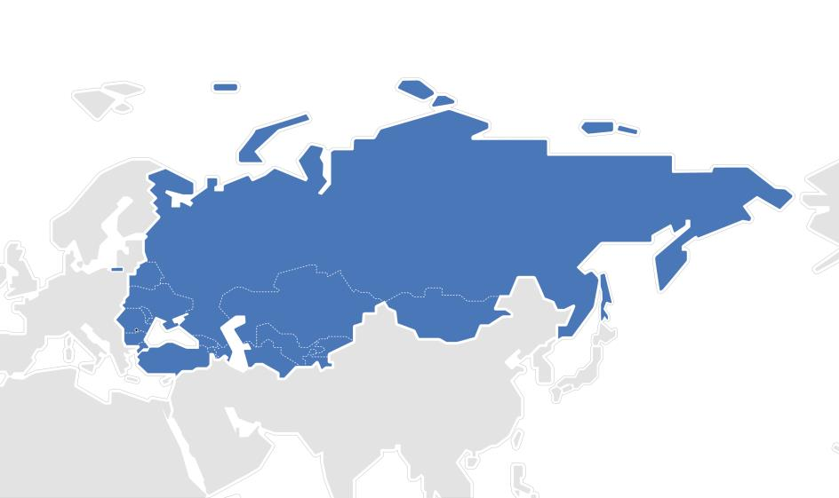
EURASIA
Russia
Belorus
Moldavia
Ukraine
Mongolia
Romania
Kazakhstan
Bulgaria
Kyrghyzstan
Turkey
Tajikistan
Turkmenistan
Uzbekistan
Georgia
Armenia
Azerbaijan

Slide 13
03
NEW AS PURCHASING ORGANISATION

Slide 14
AS ORGANISATION IN EURASIA
With the creation of new BU all the local purchasing organizations will manage from the same person with the same objectives of BU

Slide 15
04
OUR EXPECTATIONS

Slide 16
What are our expectations?
  Industrially Turkey is the most capable country in the region. We want to use this capacity to have a complete :
      AS product range for our client
      Motrio range for all the brands
      And also Accessories
  Our objective is to make purchasing for all region countries in first step. Then we want to supply for AMI region where the client profile and product range are same. To realize this growth our priorities are :
      Best P0 purchasing price
      Volume rebate

Slide 17
05
QUESTIONS & ANSWERS

