Slide 1
Vehicle Industry Outlook: Near and Far
Jonathon Poskitt
Director, Global Sales Forecasts, LMC Automotive
TAYSAD Aftermarket Conference, Istanbul
26 May 2017

Slide 2
Outline
Near
Current environment
Light Vehicle demand outlook
Implications for production
Far
Disruptive forces:
Sharing
Autonomous vehicles

Slide 3
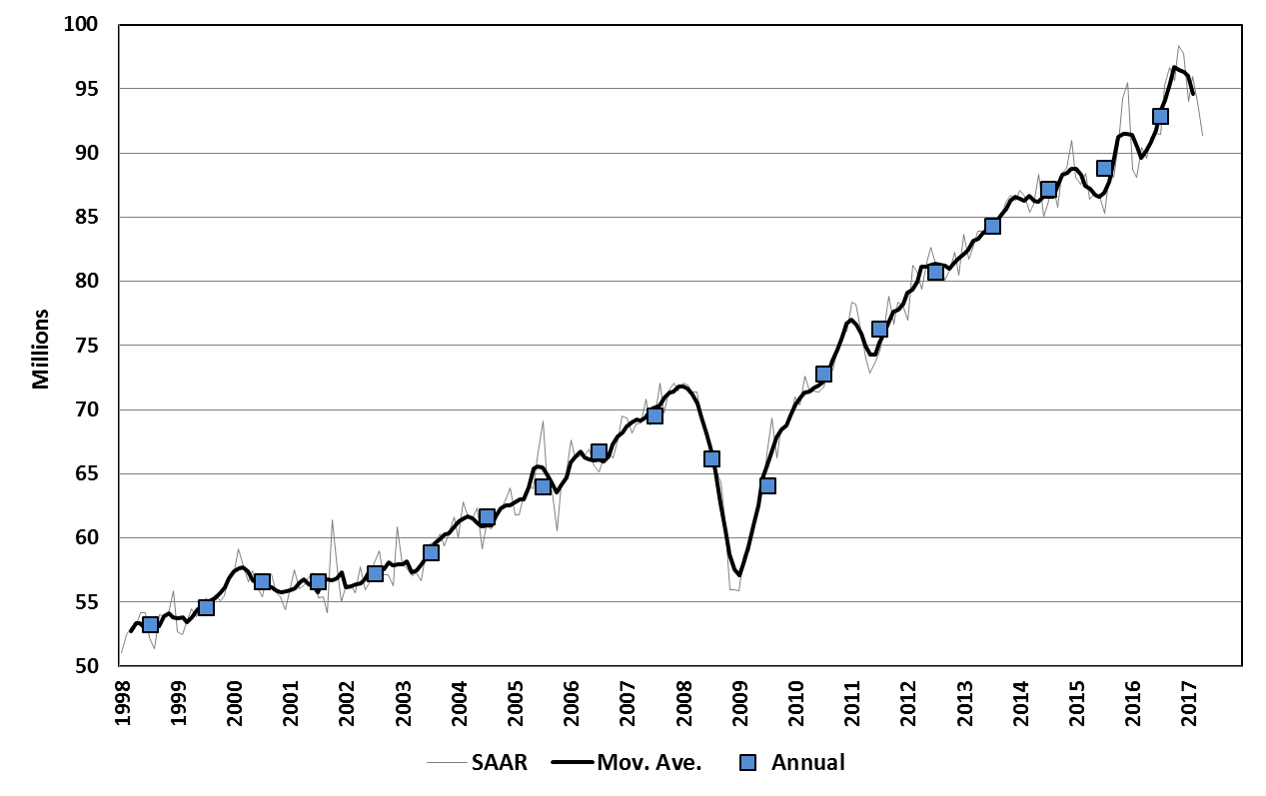
Global LV sales: upward momentum continues
Millions
Global Light Vehicle sales, seasonally adjusted and annualized
Q1 2017
SAAR =
94.6 mn
Source: LMC Automotive

Slide 4
Near-term: World economy slowly improving
Currently stable, political risk
Weak, but improving prospects
Major recession, poor recovery
Slow but steady
Stable, but some risk
Managed slowdown
Solid potential, demonetization risk
Steady, emerging upside?
Major recession, slow recovery
Solid now, but risk from Brexit
Slow but some gains likely in ‘17
Source: Oxford Economics

Slide 5

Global Vehicle market, now for 8th year of growth
The pre-2017 themes of expansion in North America, Western Europe and China are expected to begin to dissipate this year, while signs of recovery in Brazil and Russia are also expected to begin to emerge.
World
15 16 17F
Western Europe
C&E Europe
15 16 17F
North America
15 16 17F
China
15 16 17F
15 16 17F
Asia-Pacific minus China
South America
15 16 17F
15 16 17F
Source: LMC Automotive

Slide 6
Which markets moved most in 2016?
Year-on-year change in Light Vehicle sales volume (thousands)
China +3,100k
India +230k
Asia-Pacific
3.4 mn
Western Europe
Italy +300k
Germany +160k
North America
Mexico +250k
C&E Europe
Russia -180k
Poland +70k
MEA
South America
Brazil -490k
-500k
Zero
+500k
+1,000k
+1,500k
Source: LMC Automotive

Slide 7
What about 2017? Market to top 95 mn units
Year-on-year change in Light Vehicle sales volume (thousands)
Asia-Pacific
China +530k
India +310k
Italy +150k
Spain +110k
UK -160k
Western Europe
North America
C&E Europe
Russia +110k
Turkey -110k
Poland +60k
MEA
South America
Brazil +70k
Argentina +130k
-500k
Zero
+500k
+1,000k
+1,500k
Source: LMC Automotive

Slide 8
North American LV demand high and stable
Millions
16-24 CAGR: +0.3%
+6.3%
+1.9%
0.0%
+0.7%
Mexico
Canada
USA
US market now in balanced position, with up and down pressures, though economic factors remain supportive of stability.
Risk to Mexican outlook, in relation to Trump administration polices, is fairly significant.
Regional outlook is solid but carries significant political-economic risk.
Source: LMC Automotive

Slide 9
European Light Vehicle sales recovery continues
Millions
16-24 CAGR: +2.1%
+2.3%
Russia
+4.8%
+2.7%
+3.1%
Other C&E Eur.
Western Europe
West European recovery continues, though grow set to slow.
Central and East European markets should continue to gain after this year.
Russian market has been bottoming out, but a rapid rebound appears unlikely without a much more robust economic recovery than is currently expected.
Source: LMC Automotive

Slide 10
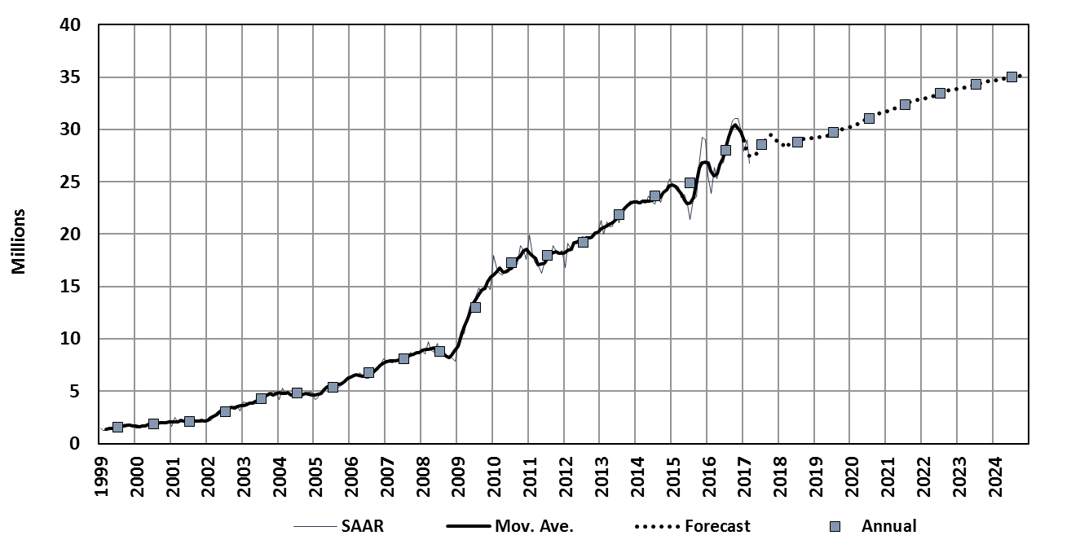
China demand also continues to rise
China Light Vehicle sales
+13%
+2%
+1%
+5%
CAGR 08-16: 16%
Adds 19 mn!
Boost to sales in late 2015 and 2016 as tax cut (on small engine vehicles) by 5%.
Buyers expected tax cut to lapse, resulting in surge in sales in late 2016. Tax cut extended but reduced for 2017 – expect another spike at end of this year.
Further incentive a distinct possibility, but growth in 2018 will vanish without this.
Growth beyond 2018 driven by mid-Tier cities, not by megacities such as Shanghai and Beijing.
Source: LMC Automotive

Slide 11
Medium term: growth from 2016 to 2020 …
Change in Light Vehicle sales volume (thousands)
China +3,000k
India +1,340k
Asia-Pacific
4.8 mn
Western Europe
Italy +400k
Spain +240k
UK -330k
North America
C&E Europe
Russia +640k
MEA
Iran +600k
South America
Brazil +480k
Argentina +220k
-500k
Zero
+500k
+1,000k
+1,500k
Source: LMC Automotive

Slide 12
Will Global growth be sustained?
Year-on-year growth, World
2016:
93 mn
2024:
112 mn
Average historical growth rates
LV Sales: 3.1%
GDP: 2.9%
Average 2015-2024 growth rates
LV Sales: 2.5%
GDP: 2.6%
Source: LMC Automotive, Oxford Economics

Slide 13
Global LV production – CAGR is 2.4% 2016-2020
Production volume growth stable through forecast horizon and
consistent with demand growth. Utilization picks up. More plants?
Global Light Vehicle production, millions
93
95
102
89
Source: LMC Automotive

Slide 14
SUVs keep coming, but must slow in the end …
SUV market share (of LVs), major markets
129 207 222 357 500?
Number of SUV models in production globally
Source: LMC Automotive

Slide 15
Light Vehicle fleet soon to hit 1.5 billion …
Global Light Vehicle parc, billions
1.6
New mobility trends do not come quickly enough to change growth dynamic (more on that later).
With sales approaching 100 mn units/year, a rising parc is inevitable – scrappage rising from ~50 mn units/year now to 60 mn units/year.
Growth focused in emerging markets, with fleet levels growing very slowly, if at all, in mature markets.
Aftermarket opportunity expands, but adds complexity for introduction of autonomous vehicles later on.
1.4
1.2
1.0
Source: LMC Automotive; LMC International

Slide 16
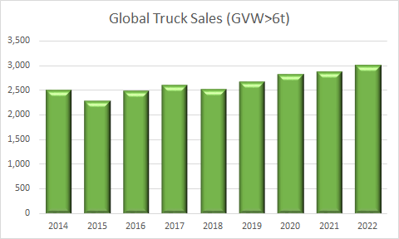
Global Truck Market Development (GVW>6t)
Global truck sales returned to growth in 2016: 2.5 mn units (+8.4%)
China driving growth in 2017
Source: LMC Automotive

Slide 17
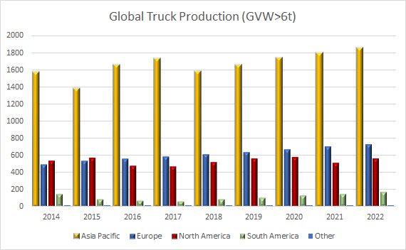
Global Truck Production (GVW>6t)
Regional balance continuing to shift away from NA
‘000s
Source: LMC Automotive

Slide 18
Outline
Near
Current environment
Light Vehicle demand outlook
Implications for production
Far
Disruptive forces:
Sharing
Autonomous vehicles

Slide 19
Ownership growing on the traditional model …
Cars in use per ‘000 adults
But what happens if ownership patterns change because of new mobility solutions?
Japan

Slide 20









Shared models continue to advance but …
… are not proving a major threat to volume
Various models now operating across the world with heavy focus on densely populated areas.
Include: ride hailing, ride sharing, car pooling and car sharing.
Economics of ownership model still wins for almost all users, in most circumstances, and even in cities.
Current (and near future) shared models mainly offers more choice for consumers and competes with ‘old’ shared models (taxi and public transport).
The real disruption would be when future automation converges with sharing.
Source: LMC Automotive

Slide 21
Vehicle autonomy: why dream of a new world?
Over 1.2 mn people killed on roads each year globally, ~30,000 each in the US and the EU – mostly driver error. Serious injuries are many multiples of this.
In mature markets, our cars are used less than 5% of the time.
Most time spent driving is exclusively for driving (or it should be) – that was 46 minutes/day in 2015 for an average American.
Congestion has been increasing in all urban areas for decades – the EU estimates at a cost of 1% of GDP.
Many people cannot drive themselves.
Source: WHO, EU, NHTSA, NSA (UK), Various

Slide 22
Challenges to the dream of full autonomy
Full Autonomy
3D Mapping
Privacy
Legal Issues & Liability
Road users, other events
Connectivity: V2X, Networks
Morality & decisions
Legacy Infrastructure
Legacy Vehicles
Industry Standards
Sensors
Cost/ Price
AI
Cyber Security
Bad Weather
Driver Intervention
Peak Hours Demand
Acceptance (Safety)
Expectations Met
Commercial Success
Insurance
Source: LMC Automotive

Slide 23
At this point, scenarios are the only way
to capture what the volume impact could be …
Slow burn
Technical difficulties
High costs
Infrastructure delays
Consumer reluctance
2040?
Moderate Progress
Success in limited areas
Incremental expansion
Breakthrough emerges in 2030s
Conventional slows, then subsequent falls
Transformative
Technological, commercial, logistical issues solved fairly quickly
Breakout from first zones to much broader usage
Transportation boom
Global Light Vehicle Sales (mn)
Level 4-5: 2 mn
Level 4-5: 8 mn
Level 4-5: 30 mn
Conventional owned-model vehicle sales – many with some, but not full, autonomy
Source: LMC Automotive

Slide 24
Summary
Expectation
Risk
Asia-Pacific growth slows with China, but more growth coming from elsewhere, not least India.
Europe to grow but Western Europe slowing; Russia to begin to come back.
North America (US) in balance now – stable outlook.
South America (Brazil) likely to remain in weak growth.
Shared economy only destroys a small amount of demand – a fraction of one year’s growth in years.
Automation will create massive change in auto industry, but unlikely to collapse total volume.
Volatility in China
Demonetization legacy extends in India
Politics: elections, Brexit
Re-emergence of Greek crisis
Upside/downside from Trump administration
Mexican boom vanishes if confidence slips
Brazil could surprise on the upside, but perhaps not yet.
Volume increase causes price drop; existing convenience barriers are innovated away.
Rapid adoption destroys conventional demand more quickly, brings future forward.
Near
Far
Source: LMC Automotive

Slide 25
jposkitt@lmc-auto.com

